Slide 1
ISCG6425 Data Warehousing Assignment 2
Vibhor Gupta | 02/Nov/2021

Slide 2
Agenda
Tasks T1 OLAP and ETL process
Creating the OLAP tables in Data Warehouse (Contd. From Task 1)
Creating a new Integration Services Project
Connection Manager
Common SSIS Toolbox Components – Sequence Container, Execute SQL Task
Extract, Transform and Load data in Integration Services Project
Common SSIS Toolbox Components – Data Flow Task, OLEDB Source, Lookup, Union, Sort, RowCount, OLEDB Destination
Logging in Integration Services Project
Custom DQ Log of data in OLAP versus OLTP
T2 Data Quality
Implementing Data Quality Rules using Conditional Split & Derived Column
Custom DQ Log of data in OLAP versus OLTP

Slide 3

Creating the OLAP tables in Data Warehouse (Contd. From Task 1)
dimTime
Role-Playing Dimension because it used multiple times within the same fact (factsale) but with different meanings
Time Key | Date | Day
-1 | 12/31/9999 | Friday
0 | 1/1/2013 | Tuesday
PK
factSale
dimEmployee
Sale Key | Time Key | Product Key | Customer Key | Employee Key | Required Date Key | Shipped Date Key
1 | 3202 | 1 | 121 | 22 | 831 | 822
2 | 3202 | 2 | 113 | 25 | 705 | 698
dimCustomer
Employee Key | Employee Number | Last Name | First Name
1 | 1002 | Murphy | Diane
2 | 1056 | Patterson | Mary
Customer Key | Customer Number | Customer Name
1 | 103 | Atelier graphique
2 | 112 | Signal Gift Stores
PK
FK
FK
FK
FK
FK
FK
PK
PK
dimProduct
Product Key | Product Code | Product Name
1 | S10_1678 | 1969 Harley Davidson Ultimate Chopper
2 | S10_1949 | 1952 Alpine Renault 1300
PK

Slide 4

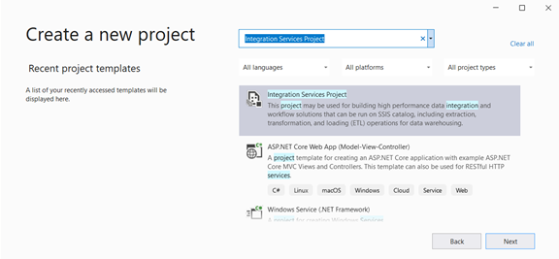
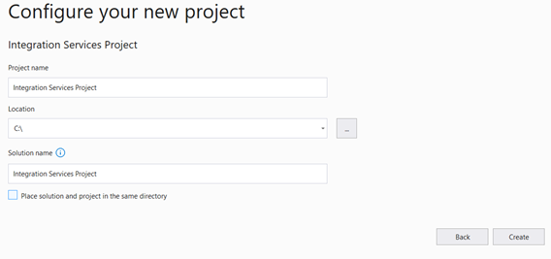
Creating a new Integration Services Project
On the Windows Start menu, search for and select Visual Studio 2019 – We are using Visual Studio S 2019 for this Project
In Visual Studio, select Create a new Project & search Integration Services Project
Click Next
In the Configure your new project, enter a Project Name box, selection the location where you’d like to save the Project & enter a solution name.
Select Create.
By default, an empty package titled Package.dtsx is created and added to your project under SSIS Packages.
Search Integration Services Project

Slide 5
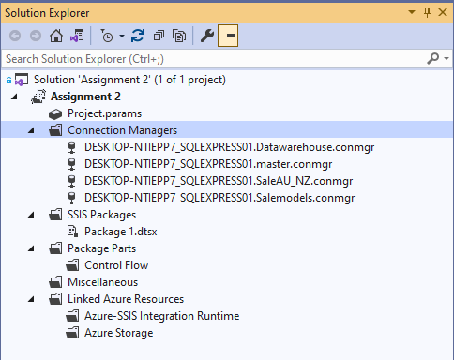
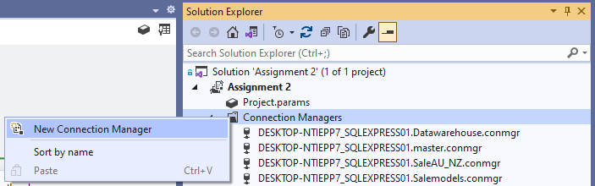
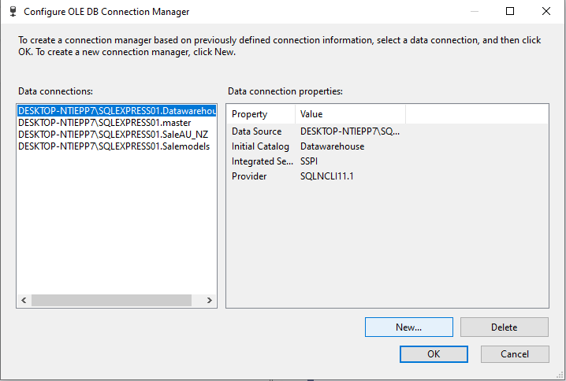
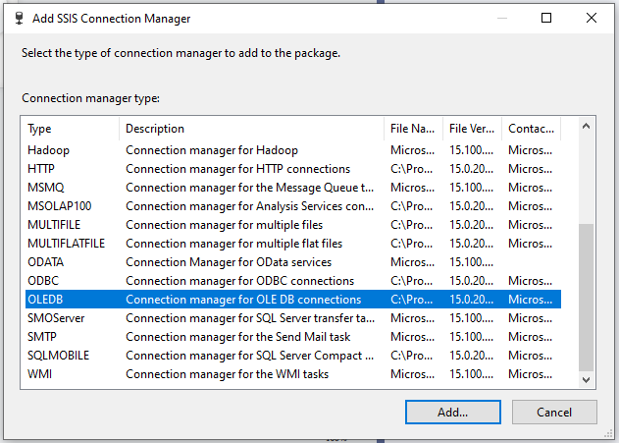
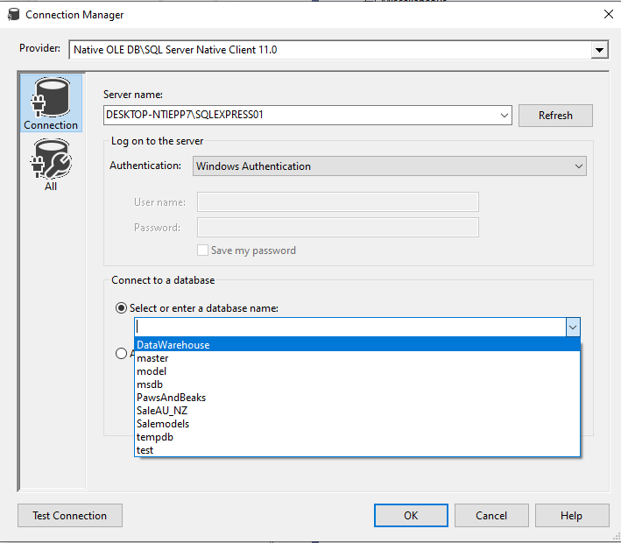
Connection Manager
In Integration Services Project , there are two types of Connection managers - Project Level Connection Managers and Package Level Connection Managers
Project Level Connection Managers - allow connections available to available to all the packages under that project. If there are multiple packages that require the same connection, then it is good practice to create Project Level Connection Managers.
Package Level Connection Managers – allow connection to that particular package only where it is configured.
In our design we are using Project Level Connection Managers for SalesAU_NZ, Salemodels & Data Warehouse

Slide 6

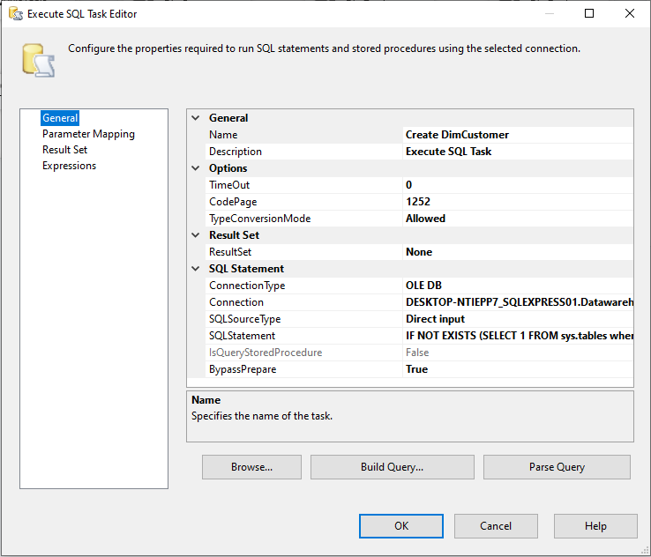
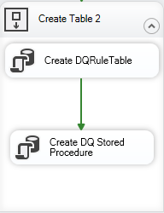
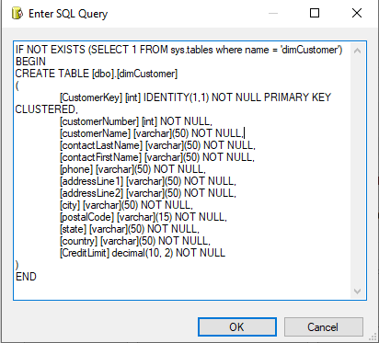
Common SSIS Toolbox Components – Sequence Container, Execute SQL Task
Execute SQL Task
Sequence Container
The Execute SQL task runs SQL statements or stored procedures from a package. The task can contain either a single SQL statement or multiple SQL statements that run sequentially
The Sequence container defines a control flow that is a subset of the package control flow. Sequence containers group the package into multiple separate control flows, each containing one or more tasks and containers that run within the overall package control flow. The Sequence container can include multiple tasks in addition to other containers

Slide 7





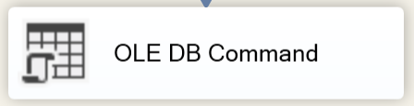
Extract, Transform and Load data in Integration Services Project
Below is the list of Common SSIS Toolbox components used in this project
Data Flow Task – Moves data between sources and destinations while transforming and cleaning. Data can be moved between tables and files while efficiently processing the data in memory with transformation. This is an essential integration services task and may be the only task in the control flow
Derived Column – Creates a new column values by applying expressions to transformation input columns. Create new column or overwrite existing ones. For example, concatenate the values from the “first name” and “last name“ column to make a “full name” column.
Row Count – Counts rows as they pass through a data flow. For example, use the number of rows processed to determine whether or not to perform cleanup operations, or update text in an e-mail message to communicate processing status.
Sort - Sorts input data in ascending or descending order when it cannot be sorted at its source. For example, sort sales data by “Customer id” before it is written to a flat file and delivered to another department.
Lookup – Joins additional columns to a data flow by looking up values in a table. For example, join to the ‘employee id’ column the employees table to get ‘hire date’ and ‘employee name’.
Ole DB Command – Runs a SQL Statement for each row in a data flow. For example, call a stored procedure for each row to update a dimension table when the data does not match with source

Slide 8
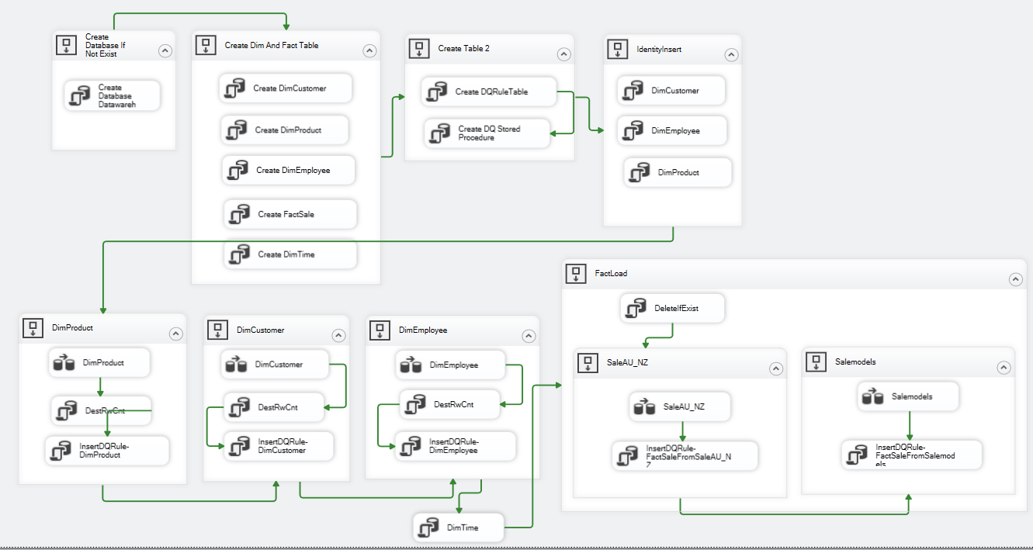
Integration Services Project – Containers & Map
Identity Insert “Unknown” into Dimension tables
Create DQ Rule Table & Proc
Create Database, Dimension & Fact Tables if not exists
Load Fact Table & DQ Rule from SaleAU_NZ & Salemodels
Load DIM Tables & DQ Rule

Slide 9
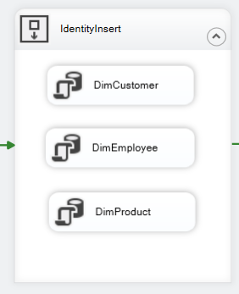
Identify Insert
If the dimension doesn’t have a value for the business key that we are trying to find, we have a problem.
Goal is to allow all data to flow through, into the fact table so we don’t lose it, but if we leave our surrogate key value NULL then it’s going to break referential integrity. It also means we must cater for nulls when joining between dimension and fact or risk our figures being inaccurate.
So, the approach we have taken here is to generate your own unknown/not assigned member key in each dimension. This is essentially a catch-all for any fact records that don’t find a match in the dimension.
Sample Script
If not exists (select 1 from dbo.DIMcustomer where CustomerKey = -1)
BEGIN
SET IDENTITY_INSERT dbo.dimcustomer ON
INSERT INTO dbo.DIMCustomer (customerkey, customerNumber, customerName, contactLastName, contactFirstName, phone, addressLine1, addressLine2, city, state, postalCode, country, CreditLimit)
Select -1,-1,'unknown','unknown','unknown','unknown','unknown','unknown','unknown','unknown','unknown','unknown', -1
SET IDENTITY_INSERT dbo.dimcustomer OFF
END

Slide 10
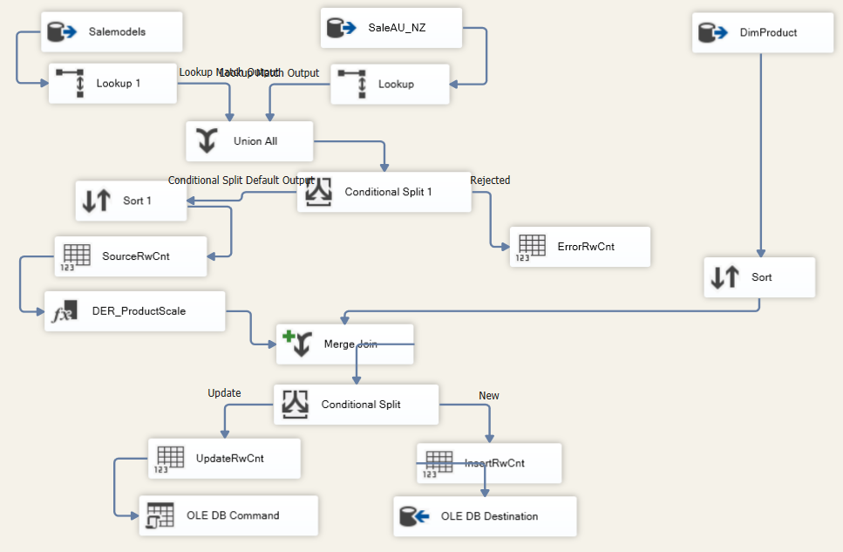
Insert & Update Dimension Tables (Understanding DimProduct Data Flow)
1
Connect to OLE DB Source – Products table in SaleAU_NZ & Salemodels
1
1
2
2
2
Lookup Productlines to get text description
3
3
Union All from Salemodels & SaleAU_NZ
4
Remove Error Records – i.e. of buyPrice = 0 or MSRP < buyPrice
5
4
5
Sort the new dataset
6
6
Parse few columns
7
7
Merge with Dim Product to remove duplicates
8
8
Split between Insert & Update
9
Insert using OLE DB Destination
10
9
10
Update using OLE DB Command

Slide 11
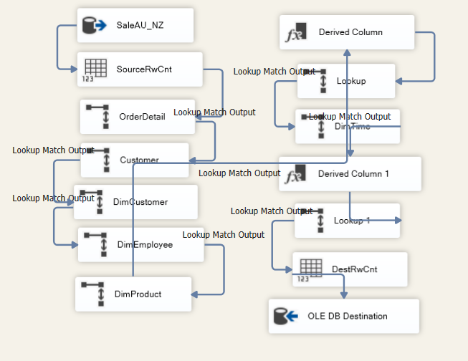
Updating Fact Table (Understanding factSale Data Flow)
1
6
Derived Column to Replace NULL
(DT_DBDATE)REPLACENULL(shippedDate,"9999-12-31")
(DT_DBDATE)REPLACENULL(requiredDate,"9999-12-31")
OLE DB Source SalesAU_NZ
dbo.productorder
2
7
Lookup DimTime to get shipped
date key
OLE DB Source SalesAU_NZ
dbo.productorder
3
8
Calculate TotalPrice = ABS(quantityOrdered) * ABS(priceEach), TotalProfit & TotalPossibleProfit
Lookup Customer to get salesrepEmployeeNumber
4
9
Lookup Dim Employee to get the Employee Key
Lookup DimTime to get TimeKey
5
10
Lookup Dim Product to get
the Product Key
Load in Fact Table – factSale

Slide 12
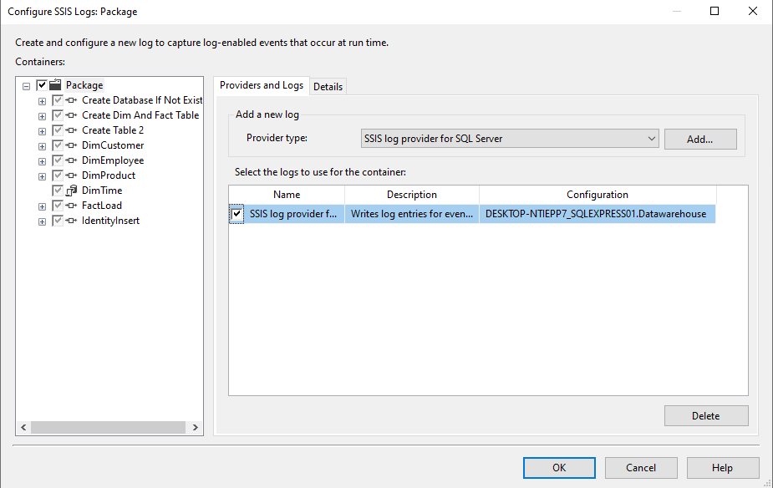
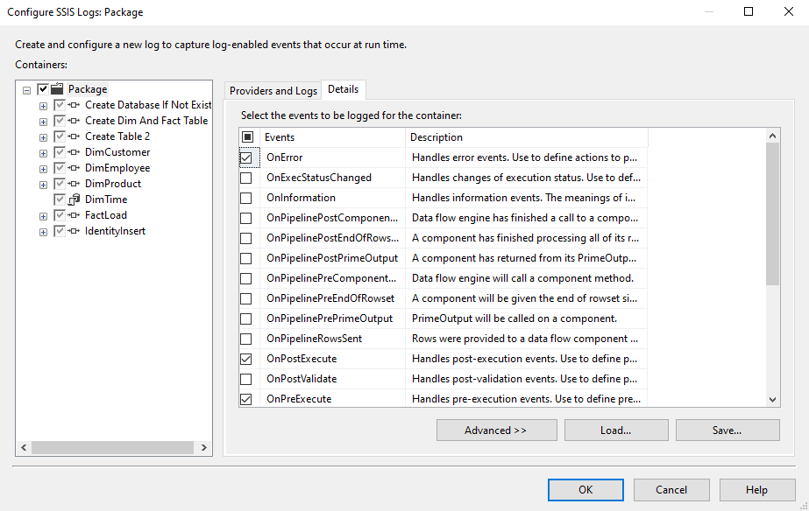
Logging in Integration Services Project
SQL Server Integration Services includes log providers that you can use to implement logging in packages, containers, and tasks. With logging, you can capture run-time information about a package, helping you audit and troubleshoot a package every time it is run. For example, a log can capture the name of the operator who ran the package and the time the package began and finished
Right click on the SSIS package and select logging to configure SSIS Package log

Slide 13
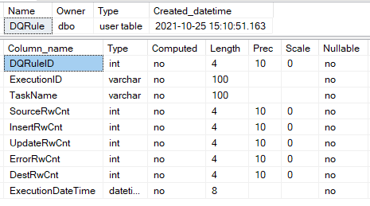
Design of Data Quality Framework in SQL Server
CREATE PROC dbo.spr_insertdqrule @ExecutionID VARCHAR(100), @TaskName VARCHAR(100), @SourceRwCnt INT, @InsertRwCnt INT, @UpdateRwCnt INT, @ErrorRwCnt INT, @DestRwCnt INT AS BEGIN INSERT INTO dbo.dqrule ( executionid, taskname, sourcerwcnt, insertrwcnt, updat erwcnt, errorrwcnt, destrwcnt ) SELECT @ExecutionID, @TaskName, @SourceRwCnt, @InsertRwCnt, @UpdateRwCnt, @ErrorRwCnt, @DestRwCnt END
Created a new SQL Table ‘DQRule’ to measure the number of records at the starting and end of each independent data load process
Created a wrapper stored procedure to capture input from external systems (Integration Services Project in our case)
DQ Rule Table Design
Data Capture Stored Procedure

Slide 14
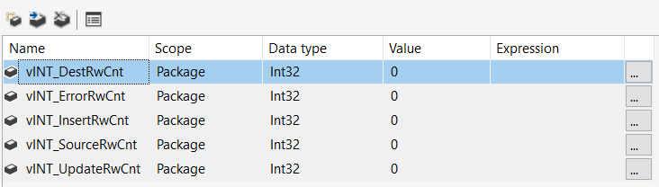
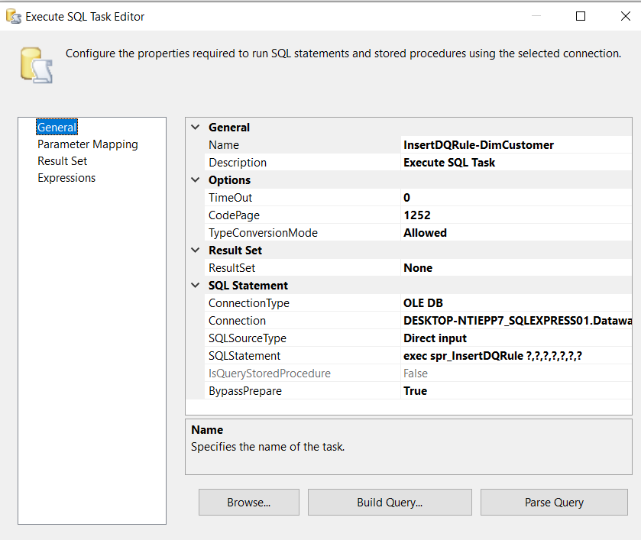
Implementing Variables
Create 5 variables in Integration Services Project to capture run-time values and implemented them on each Data Flow. Local variable is an object can hold a single data value of a specific type. Variables in batches and scripts are typically used as a counter either to count the number of times a loop is performed or to control how many times the loop is performed.
Add a new Execute SQL Task under each dimension load Sequence container with the following SQL Statement
EXEC SPR_InsertDQRule ?,?,?,?,?,?,?

Slide 15
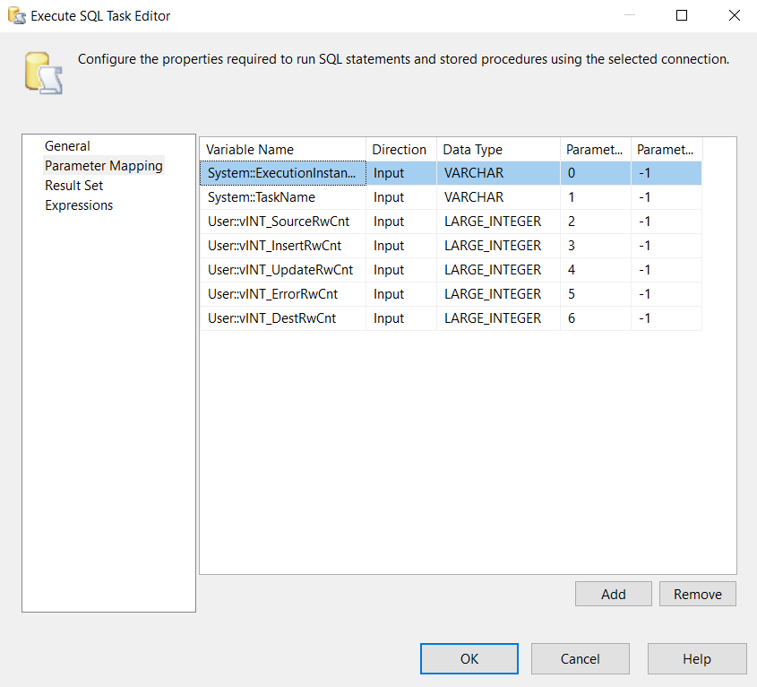
Implementing Variables (contd.)
Map variables into the Parameter Mapping section of the Execute SQL Task. Variables must be mapped in the same order as they are expected

Slide 16
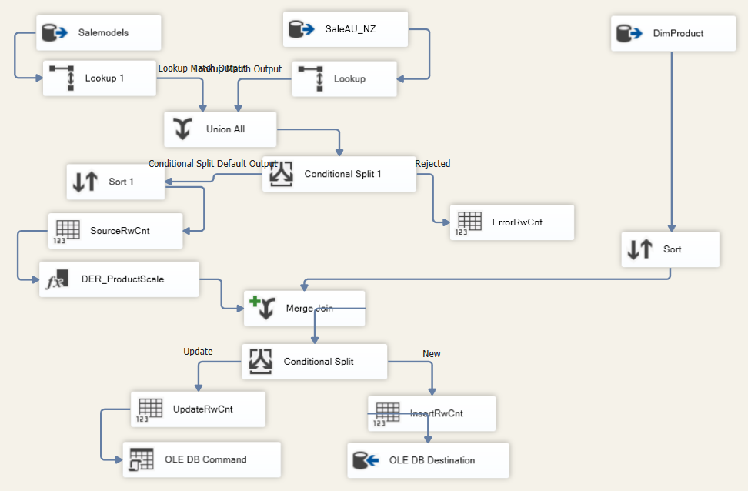
Capturing Data into Variables (DQ RULES)
Error (DQ Rule Failure) Row Count
Source Row Count
Insert Row Count
Update Row Count

Slide 17
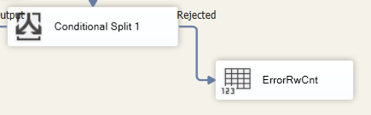
Implementing Data Quality Rules – Data Flow Task
Rule No. | Description | Action (If-Then) | Implemented (in) | SSIS Rule
1 | buyPrice checking in Products | Reject if buyPrice is 0 or Null Fix if buyPrice is negative, need to convert to positive number | Dim Product | (ISNULL(buyPrice) || buyPrice == 0) || (MSRP < ABS(buyPrice))
2 | priceEach checking in orderDetails | Reject if priceEach is 0 or Null Fix if priceEach is negative, need to convert to positive number
3 | QuantityOrdered checking in Order Details | Reject if Quantity Ordered is Null or 0 Fix if Quantity Ordered is negative, need to convert to positive number
4 | MSRP checking in Product | Reject if MSRP < buyPrice on a product | Dim Product | (ISNULL(buyPrice) || buyPrice == 0) || (MSRP < ABS(buyPrice))
5 | Country checking in Customers and Offices | Fix the Country format regardless capital or non-capital cases, e.g. US, United States, UNITED STATES → USA (in saleAU_NZ) Australia → AU New Zealand → NZ
6 | ProductCode checking in Order Details | Reject if ProductCode doesn’t exist or is null
7 | CustomerNumber, addressLine1, addressLine2 and City checking in Customers | Reject if (CustomerNumber doesn’t exist or is null) and (if any of: addressLine1, addressLine2 and City are null)
8 | requiredDate, shippedDate checking in Orders, | if orderDate greater than requiredDate, Fix if requiredDate null replace orderDate+7 if orderDate greater than shippedDate Fix if shippedDate null replace orderDate+2, if status is ='Shipped'

Slide 18
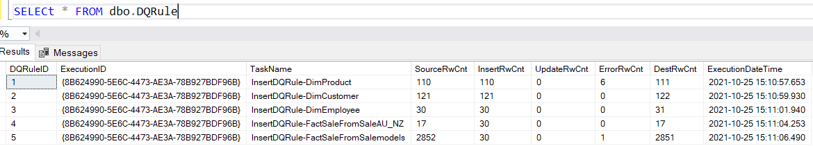
Data Quality Framework (Output)

Slide 19
Questions?

